Slide 1
Nolan W. Lloyd, Chief Well Inspector Divison of Water Resources

Slide 2
Gallery Type Well

Slide 3
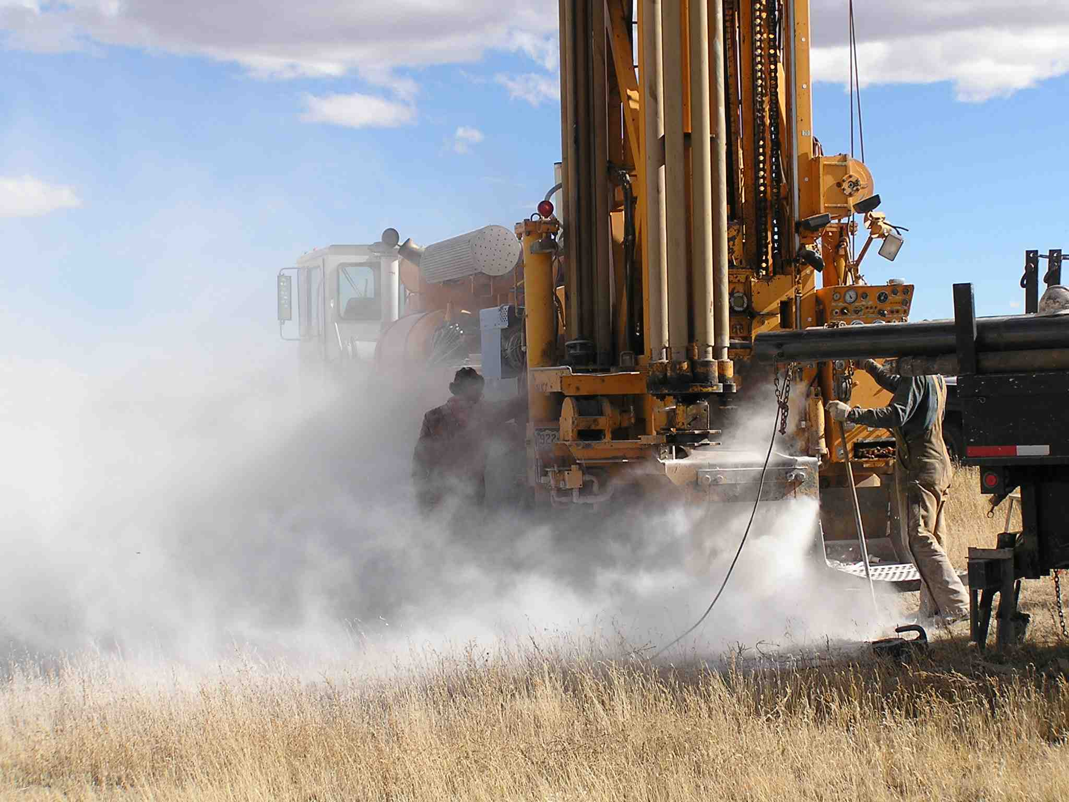
Air Rotary

Slide 4
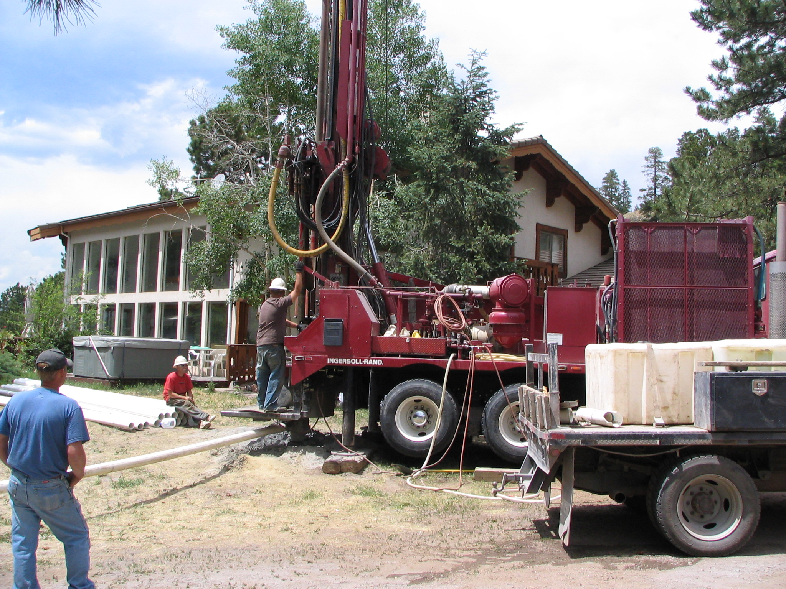

Slide 5
Mud Rotary with Portable Pit

Slide 6
Mud Rotary with dug pit

Slide 7
Rotary Drill Tools

Slide 8
Tricone / Roller Bit

Slide 9
Drag Bit

Slide 10
Welding Steel Casing

Slide 11
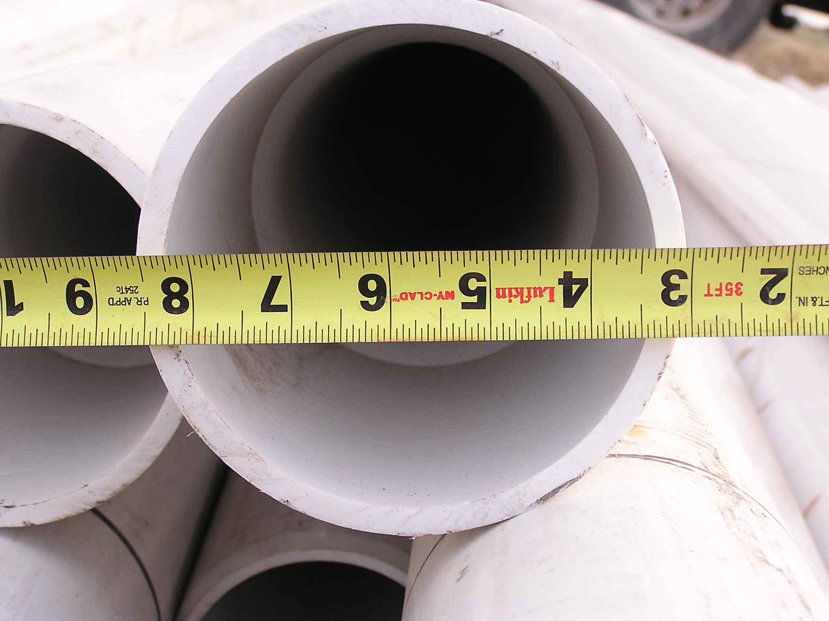

Slide 12
Stainless Steel Well Screen

Slide 13
PVC Screen

Slide 14
Hand Cut

Slide 15
Torch Cut

Slide 16
Pitless Adapter

Slide 17
Completed Well / Pitless Installation

Slide 18
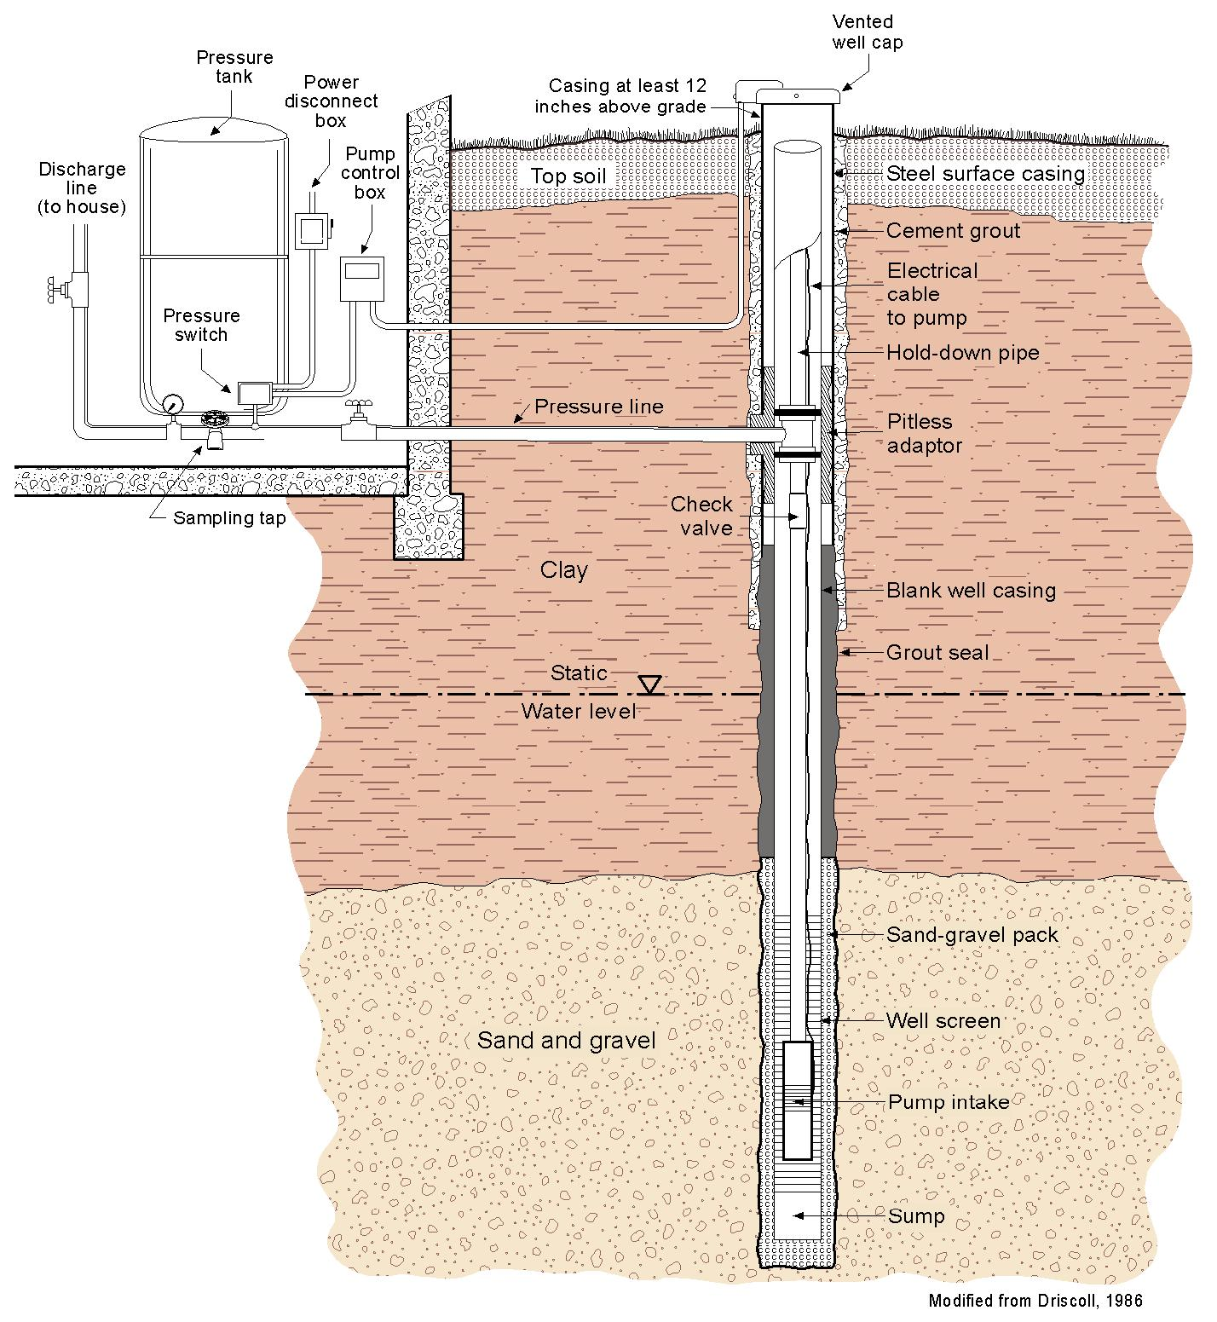
Domestic Well Completion

Slide 19
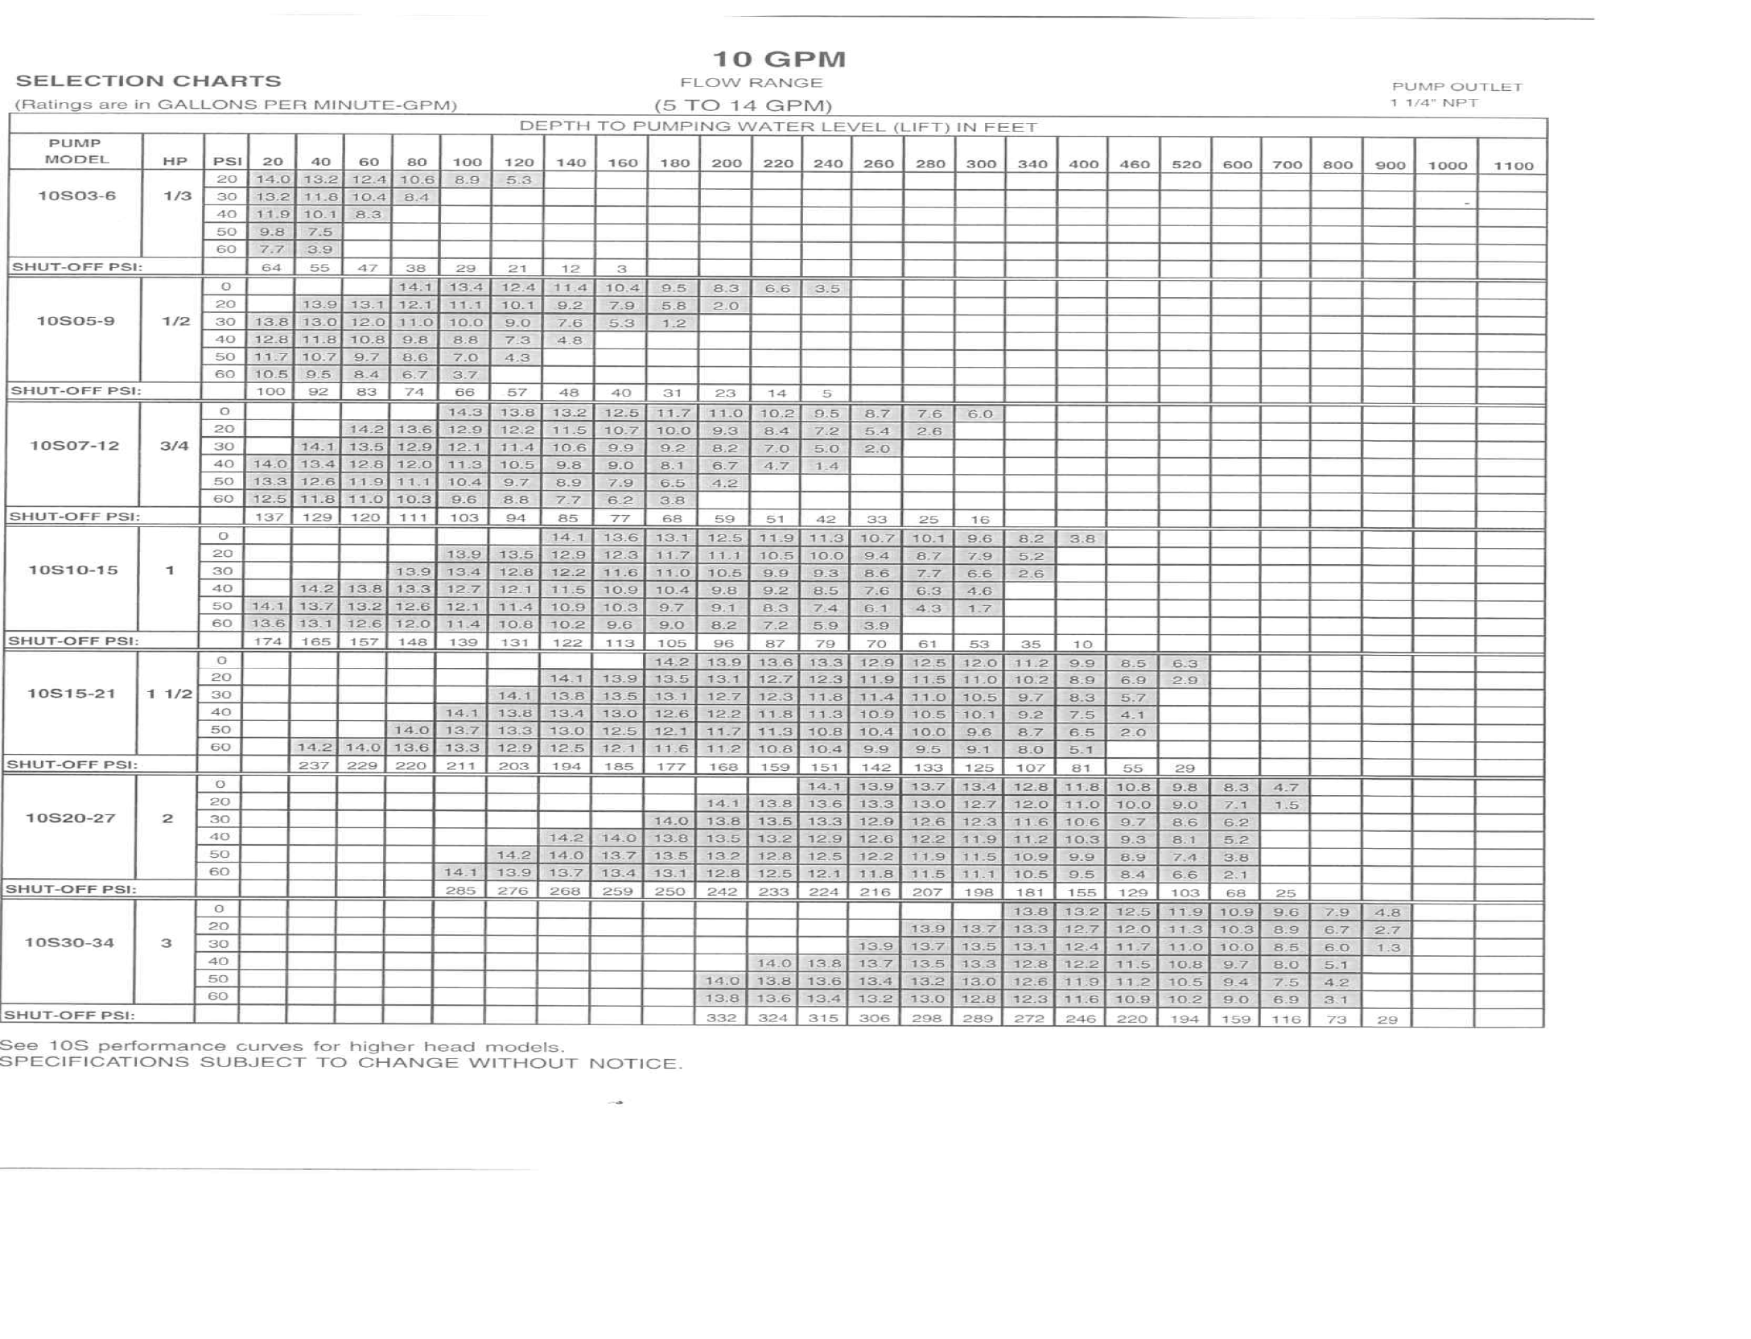

Slide 21
One ounce of dry HTH or equal powder (70 % available Chlorine) dissolved in 52.2 gallons of water makes a 100 ppm strength disinfectant solution. One cup of liquid household bleach (5% available chlorine) mixed into 31.2 gallons of water makes a 100 ppm strength disinfectant solution. Various proportions can be calculated using the following approximate quantities: Approximate amount of dry powder or liquid bleach required for a 100 ppm chlorine solution
Diameter of water column (inches) | Volume of water in 100 feet of column (gallons) | Cups of dry powder 1) | Cups of liquid bleach 2)
4 | 65.5 | ¼ | 3
6 | 147 | ½ | 5
8 | 261 | ¾ | 9
10 | 408 | 1 | 14
12 | 587 | 1 ½ | 19

Slide 23
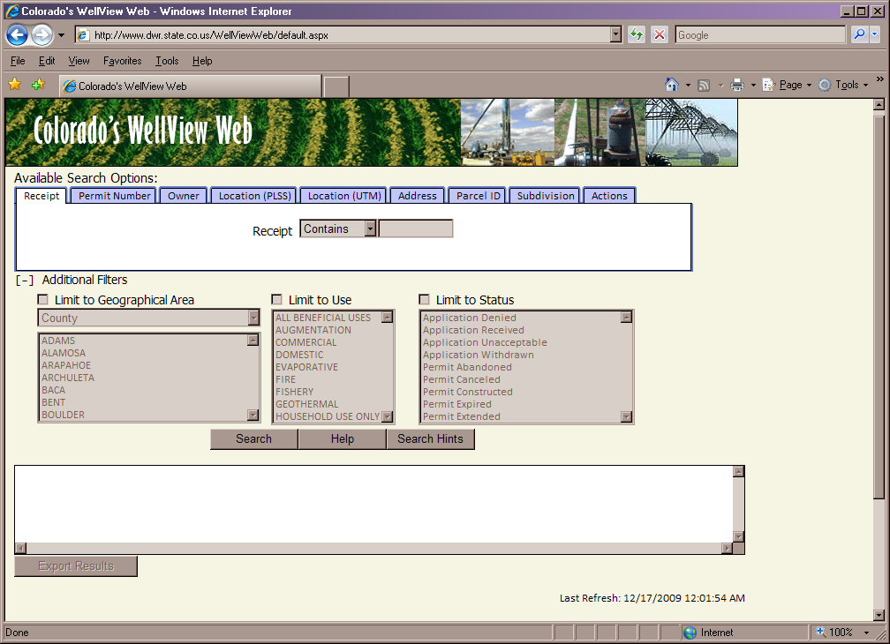

Slide 24
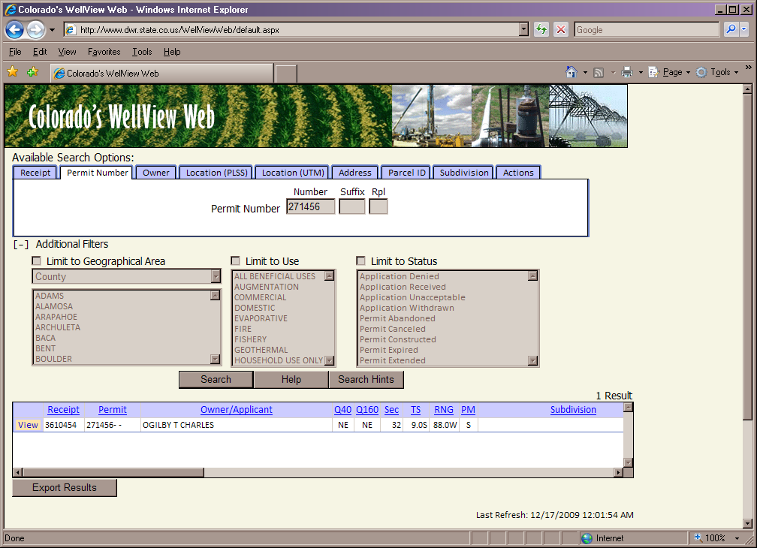

Slide 25
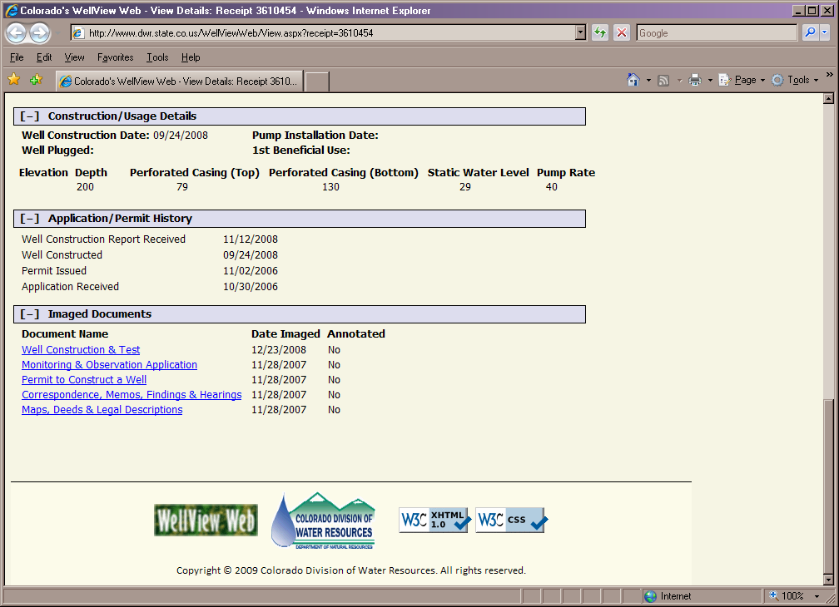

Slide 30
